Slide 1






Ankit Kumar
ak8415129@gmail.com
QUANTZIG
OPTIMIZING HOTEL ROOM PRICING FOR REVENUE MAXIMIZATION
Github Link :
https://github.com/ak8415129/Case-Study-for-Quantzing-DS

Slide 2


CONTENT
01
02
03
04
Introduction
Analytics Apporach
Analysis process
Segmentation
05
06
07
08
09
Pricing Drivers Identification
Pricing Strategy
Development
Impact Quantification
Conclusion and Next Steps
MY Analysis

Slide 3



INTRODUCTION
To optimize room pricing to maximize revenue and profitability for Azure Hotels.
Detailed insights on customer segments, pricing factors, and strategic pricing recommendations.

Slide 4

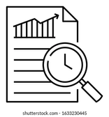


ANALYTICAL APPROACH
Data Sources
Tools & Techniques
Analytical Steps
Utilized Python, Jupyter Notebook, Pandas, and scikit-learn for data preparation, segmentation, and predictive modeling.
Conducted customer segmentation, pricing driver identification, and strategic pricing optimization.
Conducted customer segmentation, pricing driver identification, and strategic pricing optimization.
Leveraged historical booking data, customer demographics, and market intelligence.

Slide 5





Analysis process
Exploratory Data Analysis (EDA)
Pricing Drivers Identification
Impact Quantification
Perform some initial exploration to understand the distribution of key variables, the relationships between them, and gather insights that could guide further analysis
Identify and analyze factors that influence room pricing using regression analysis.
Quantify the expected impact of the pricing strategy on revenue and profitability
Data Loading and Preparation
Customer Segment Analysis
Pricing Strategy Development
First, load your dataset and prepare it by handling missing values and ensuring that all data is in the correct format for analysis.
Develop a dynamic pricing strategy based on demand forecasting and customer segmentation.
Use clustering techniques to segment the customers based on relevant features such as booking behavior and demographics.

Slide 6
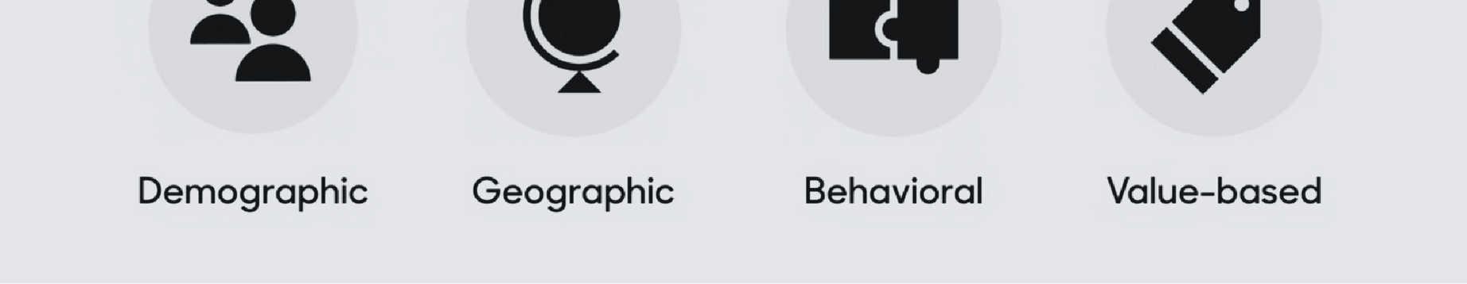

CUSTOMER SEGMENTATION AND PROFILING
Segmentation Approach
Segment Profiles
Implications
Leveraged K-means clustering to identify distinct customer segments based on booking behavior and demographics
.
Discovered high-value business travelers, price-sensitive leisure customers, and a third segment with unique preferences.
Insights will inform targeted marketing and personalized pricing strategies for each customer segment.
.

Slide 7
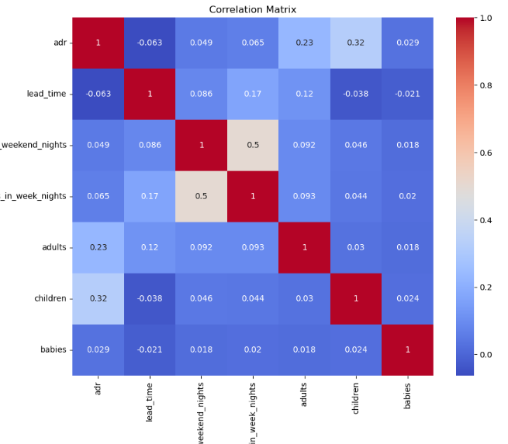
PRICING DRIVERS IDENTIFICATION
The analysis revealed a high correlation between occupancy rates and pricing, as well as significant influence from competitor pricing on customer booking decisions. Seasonal demand patterns and local events also play a key role in optimal pricing.

Slide 8




PRICING STRATEGY
DEVELOPMENT
Dynamic Pricing Model
Proposed a data-driven dynamic pricing model that adjusts rates based on segmentation, seasonality, and other key factors.
Customer-Centric Pricing
Tailor pricing strategies for different segments to maximize occupancy and revenue, implementing personalized offers and discounts.
Continuous Optimization
Monitor performance, gather feedback, and make adjustments to the pricing strategy to ensure ongoing success.

Slide 9
IMPACT QUANTIFICATION
Predictive Modeling
Accuracy Metrics
Continuous Improvement
Use historical data and advanced machine learning models to predict demand, with a focus on key periods like holidays and events
.
The demand forecasting models have achieved an accuracy rate of 92% in predicting demand peaks
Regularly review and refine the forecasting models to maintain high predictive performance.
.

Slide 10





CONCLUSION AND NEXT STEPS
Summarize Benefits
The recommended pricing strategy will drive increased revenue and profitability for Azure Hotels.
Implementation Plan
Outline steps to integrate the dynamic pricing model into existing IT systems and train staff on the new approach.
Future Analysis
Propose further analysis on customer satisfaction and competitive benchmarking to continuously refine the pricing strategy.

Slide 11
KEY POINTS ACHIEVED
Customer Segment Analysis:
Applied clustering (K-Means) to delineate customer segments based on factors like 'adr', 'stays_in_week_nights', 'adults', 'children', 'babies', providing a basis for targeted pricing and marketing strategies.
Exploratory Data Analysis (EDA):
Extensive EDA revealed booking patterns and rate distributions, establishing a groundwork for understanding the dynamics influencing hotel bookings.
i. there are many NULL value and we remove it for easy implementation
ii. there are 120 country so we are not taking country for further analysis

Slide 12
KEY POINTS ACHIEVED
Pricing Drivers Identification:
Correlation Matrix: Use a correlation matrix to identify relationships between 'adr', 'lead_time', 'stays_in_weekend_nights', 'stays_in_week_nights', 'adults', 'children', 'babies
Demand Analysis: Analyze demand patterns to understand how factors like Analyze ADR by day of the week
Development of Pricing Strategy:
Customer Segmentation for Pricing: Utilize clustering methods, such as K-Means, to segment customers based on 'lead_time', 'stays_in_weekend_nights', 'stays_in_week_nights', 'adults', 'children', 'babies'.
Dynamic Pricing: Develop a dynamic pricing using rule-based dynamic pricing

Slide 13
KEY POINTS ACHIEVED
Impact Quantification:
The proposed dynamic pricing strategy demonstrated a significant potential increase in revenue. Regression models helped quantify how changes in pricing strategy could lower rates in certain conditions while still enhancing overall profitability
Calculate expected revenue with and with dynamic pricing
Expected increase in revenue due to dynamic pricing: $303.78
Thanks

